Slide 1
THE GENETIC MANIPULATION OF PEST RESISTANCE

Slide 2
INTRODUCTION
Genetic engineering, also called genetic modification, is the direct manipulation of an organism's genes using biotechnology.
It is a set of technologies used to change the genetic makeup of cells.
It includes the transfer of genes within and across species boundaries to produce improved or novel organisms.
Genetic engineering has been applied in numerous fields including research, medicine, industrial biotechnology and agriculture.

Slide 3
CONTINUE……
Pesticide resistance describes the decreased susceptibility of a pest population to a pesticide that was previously effective at controlling the pest.
Pesticide resistance is increasing.
Farmers in the US lost 7% of their crops to pests in the 1940s; over the 1980s and 1990s, the loss was 13%, even though more pesticides were being used. Over 500 species of pests have evolved a resistance to a pesticide.
Other sources estimate the number to be around 1000 species since 1945.

Slide 4
COMMON INSECT PESTS OF MAJOR CROPS
INSECT SPECIES | COMMON NAME OF PEST | ORDER | CROPS AFFECTED
Helicoverpa armigera | Cotton bollworm | Lepidoptera | Cotton, Maize
Helicoverpa zea | Corn earworm, tomato fruitworm | Lepidoptera | Cotton, Maize
Manduca sexta | Tobacco hornworm | Lepidoptera | Tobacco, Tomato, Potato
Locusta migratoria | Locust | Orthoptera | Grasses

Slide 5
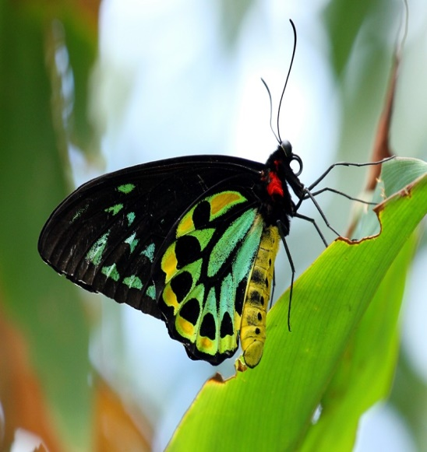
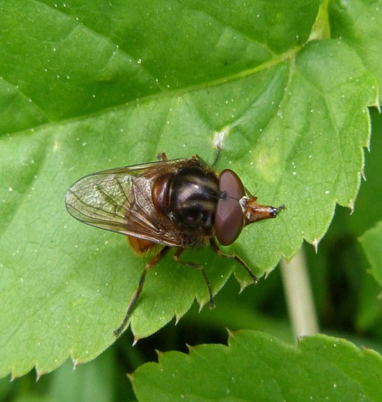
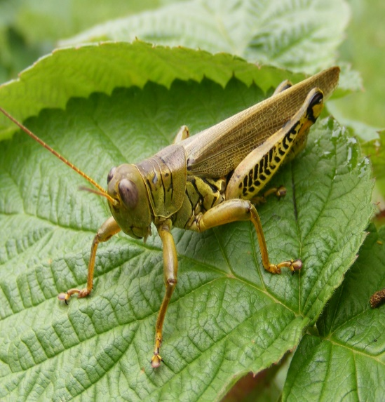
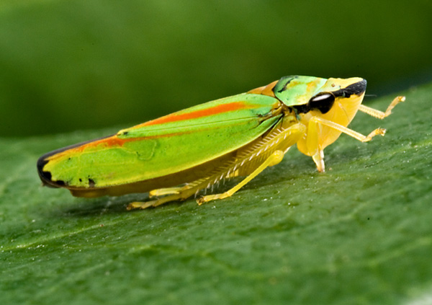
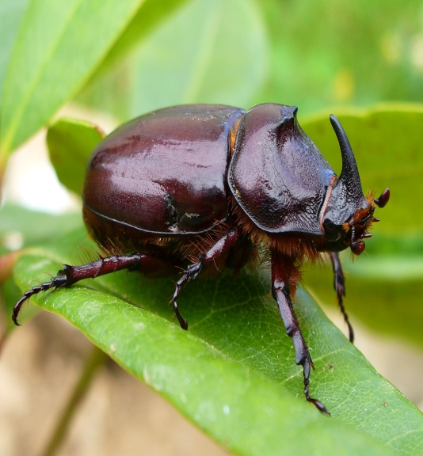
CLASSES OF INSECT THAT CAUSE CROP DAMAGE
CLASSES OF INSECT
ORDER LEPIDOPTERA
ORDER DIPTERA
ORDER ORTHOPTERA
ORDER HOMOPTERA
ORDER COLEOPTERA

Slide 6
GM STRATEGIES FOR INSECT RESISTANCE: THE Bt APPROACH
There are two approaches for insect resistance:
FIRST ---- the use of bacterial insecticidal genes to provide protection from pest damage.
SECOND---- the potential for using endogenous plant-protection mechanisms (the copy nature approach).
EXAMPLE---- the most widespread example is the use of the cry endotoxin genes from Bacillus thuringenesis.

Slide 7
INSECTICIDAL CRYSTAL PROTEIN (ICP)
The bacteria produces an ICP , which forms inclusion bodies of cuboidal crystals during sporulation.
ICP are one of the several classes of endotoxins produced by the sporulating bacteria; they were originally classified as δ-endotoxins, to distinguish them from other classes of α-, β-endotoxins.
The cry genes are carried on plasmids and belong to a superfamily of related genes.

Slide 8
COMPARISON OF THE STRUCTURES OF CLASSES OF cry PROTEINS

Slide 9
cry PROTEINS
There are large differences in size among different cry proteins.
The large size proteins are of ≈130kDa and smaller protein size is ≈70kDa.
There is a considerable difference in size among different subfamilies but they share a common active core comprising three domains.
The N-terminal end of each gene has a similar organization.
The larger proteins such as cry1 group are inactive, and are activated by proteolytic removal of the C-terminal sequence.

Slide 10
THREE DOMAINS
DOMAINS
DOMAIN I
DOMAIN III
DOMAIN II
Comprises a series of α-helices at N-terminal end.
Arranged in a cylindrical confirmation.
Is a β-sandwich with a number of putative roles.
Protection from degradation, toxin-bilayer interaction and receptor binding.
Comprises a triple β-sheet.
Involved in receptor recognition.

Slide 11
RIBBON MODEL OF THE Cry1Aa TOXIN MOLECULE
α-helical cylinder
Membrane insertion
Pore formation
Domain II and III are involved in recognition and binding to receptors in the insect midgut wall.

Slide 12
MODE OF ACTION OF δ-ENDOTOXINS
It involves specific interaction between protein and the insect larva midgut.
After ingestion, protein are solubilized in its midgut.
The larger protein such as 130-kDa Cry1 group are proteolytically cleaved to release the active 55-70-kDa active fragment of protein.
This interacts with high-affinity receptors in the midgut.
The result of this binding is to open cation-selective pores in the membrane.

Slide 13
CONTINUE……
The flow of cations into the cells results in osmotic lysis of the midgut epithelium cells, causing their destruction.
Thus, the δ-endotoxins are extremely toxic and can be lethal to susceptible insect larvae at relatively low concentrations.
On the other hand their toxicity to other animals is extremely low.
The conditions in the insect larvae vary according to insect class. The midgut of Lepidoptera and Diptera is mildly alkaline, whereas the Coleopteran gut is more alkaline or acidic.

Slide 14
DIAGRAMMATIC REPRESENTATION OF δ-ENDOTOXIN

Slide 15
THE USE OF Bt AS A BIO PESTICIDE
Preparations of Bt spores or isolated crystals have now been used as an “organic” pesticide for half a centaury.
But the isolated crystals have limited persistence on foliage of a few days.
The spores preparations are effective for about 40 days on foliage and up to 2 years in soil.
.

Slide 16
DRAWBACKS
The above mentioned methods are not systemic, because there is lack of effective penetration, due to concealed surface and organs of the plants or against sap sucking insects
Note: Bt is used as shorthand for crops transformed with a cry gene (Bt cotton) and also for Cry proteins (Bt protein).
Bt, Cry, ICP and _{ᵟ}-endotoxin are different terms used to describe the Bt proteins.

Slide 17
Bt-BASED GENETIC MODIFICATION OF PLANTS
The first attempts were made to express Cry 1A and Cry 3A proteins under control of the cauliflower mosaic virus (CaMV) 35S or Agrobacterium T-DNA promoters.
It resulted in very low level of expression in tobacco, tomato, and potato.
It was realized that the prokaryotic gene sequence itself would need to be modified extensively to obtain high levels of stable expression.
Eventually the expression was enhanced by 100-fold (i.e. 100ng of Bt protein per mg of total protein) to give much better levels of expression.

Slide 18
EFFECT
Subsequent laboratory tests showed that the effect of producing specific Cry protein at this level was to provide a considerable degree of protection against damage by susceptible insect larvae.
This resulted in the first Bt crops gaining approval for commercial planting in the USA in the mid-1990s.
The success of the Bt approach led to the development of Bt crops by several of the major biotechnology companies involved in crop protection.

Slide 19
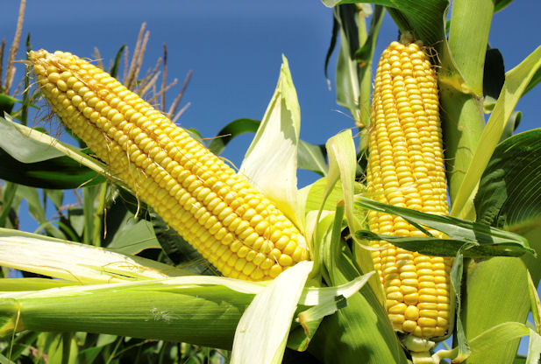
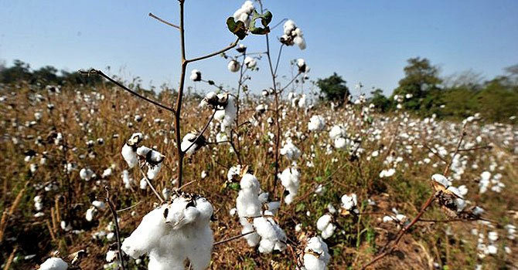
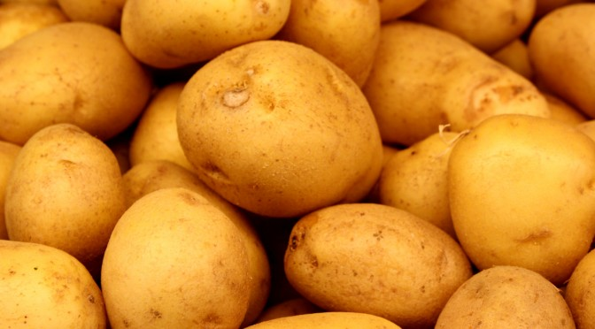
SUCCESS OR FAILURE
The nature of cry gene construct can be important for the success or failure of a particular transgenic plant.
Maiz and cotton are the only Bt crops that are currently grown commercially in the USA.
The NewLeaf Bt potato has now been discontinued.

Slide 20
THE PROBLEM OF INSECT RESISTANCE TO Bt
The accelerating use of Bt Technology for insect resistance causes a problem of rapid appearance of resistant pests
This problem initially attracted wide spread attention during the first commercial growing season of BT Cotton crop
Cause of this problem
Repeated growing of Bt crops in the same area accelerating the appearance of resistant pest population

Slide 21
STRATEGIES TO COUNTERING THE BUILD UP OF INSECT RESISTANCE
Pyramiding
It is possible to use more than one transgenes this process is called pyramiding
In pyramiding, transgenes are successively stacked by conventional crosses between different transgenic lines
Example of pyramiding
Monsanto’s Bollgard 2 is a new line of transgenic cotton developed by stacking of second Bt gene (Cry2Ab) with Cry1Ac to prevent the development of resistant cotton bollworm and to provide protection against beet armyworm and full armyworm.
Many of the commercial BT trades are also start with herbicide tolerant traits.

Slide 22
CHIMAERIC PROTEINS
Another GM approach is to further enhance the effectiveness and range of activities of cry genes by domain engineering to produce chimaeric proteins
Example
Hybrid gene SN19 was created by fusing domains 1 and 3 of cry1Ba with domain 2 of cry2a. Transformation of potato plants with this gene provided resistance against three significant pests that are Colorado potato beetle, European corn borer and potato Tuber moth larvae.

Slide 23
Another approach is to look beyond the large family of Bt genes to find other bacterial insecticidal genes
Candidates which are under study include members of the vagetative insecticidal protein (Vip) family.
Another bacterial gene that has attracted interest is the toxin A (TcdA) gene of Photorhabdus luminescens. Transformation of Arabidopsis with a large tcdA gene makes the plant resistant to tobacco hornworm

Slide 24
INTEGRATED PEST MANAGEMENT
This strategy take into consideration the wider context of pest-crop interaction( natural predators, adjacent plant species, crop rotation and chemical sprays). Selective usage of Bt crops that is rotating Bt crops with non Bt crops may prevent the build up of resistance in the insect population

Slide 25
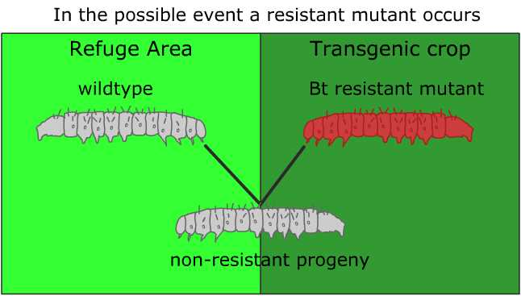
HIGH DOSE\REFUGE APPROACH
In this strategy, transgenic crops expressing a high dose of Bt protein are grown alongside a smaller refuge of non transgenic crop or any other plant that the insect pest feeds upon.
Fields with Bt crops are required to provide refuge areas to help control resistance. The refuge area supply a source of wildtype (non-mutant) insects to mate with possible resistant insects to produce nonresistant insects.
It is use for pest resistance management to manage the build up of Bt resistance

Slide 26
THE ENVIRONMENTAL IMPACT OF Bt CROPS
The environmental issue of BT crops was appeared in the report in 1999 which indicates that Pollen from BT Maize is toxic to the larva of Monarch butterfly
But still commercial growing of BT 176 crop was appeared
Solution
There should be risk assessing and monitoring of environment impact of GM crops more thoroughly

Slide 27
‘copy Nature’ STRATEGY
A ‘copy Nature’ strategy for insect pest control is presented which to be relatively sustainable and environmentally friendly. Many higher plant genes encoding insecticidal proteins exist in Nature which can be expressed in transgenic plants in a tissue or development-specific manner, or in response to environmental stimuli. These genes can either be expressed singly or in combination so as to enhance host resistance to insect pests.
The aim of the copy Nature strategy has been stated as: insect pest control which is relatively sustainable and environmentally friendly. The strategies recognizes Complex interplay in biological communities between plants, animals, microbes, the soil and the physical environment.

Slide 28
DEVELOPMENT OF PEST RESISTANT CROPS
This strategy involves a rational approach to the development of pest resistant crops and is characterized by the following steps.
1.Identification of leads
The point here is to look in nature for plants that shows resistance to insect pest. These leads can be found in the literature, world seed collection or observation in the field. The identification of resistant plants provides the starting point for the discovery of plant genes that could confer resistant to insect damage.

Slide 29
2.Protein purification
The next stage of the process is the purification of proteins with insecticidal properties. Proteins are the Primary target for this type of screen because they provide the most direct way to isolate corresponding genes.
Partial Sequencing of the purified protein is one method for isolating the corresponding gene.

Slide 30
3.Artificial-dietbioassay It is important to determine the activity of the isolated protein against the target insect pests by performing feeding assays in the laboratory.
4.Mammalian toxicity testing
Prior to any insertion of the gene into a crop plant, the toxicity of the protein against mammals (and hence potentially humans) should be tested. The point is that it would be a waste of time inserting a gene into a plants that subsequently was found to cause concerns about food safety.

Slide 31
5.Genetic engineering
It is the only at this stage that the isolated gene would be considered valuable for transfer to crop plants.
one particular consideration for pest- resistance contract is the choice of promoter. Although it is possible to rely on a strong, constitutive promoter such as CaMv 35S, there are are certain advantages to using either a tissue specific promoter or on wound inducible promoter.

Slide 32
6.Selection and testing After transformation, the selection of transgenic plants, confirmation of transformation, Inheritance of transgenes in T1, T2 etc. generations and testing of expression levels need to be carried out.
7.Biosafety
The effect of the transgene on crop yield, insect damage, and the wider ecosystem should be properly evaluated in field trials, rather than after several years of commercial planting, as occurred with BT crops

Slide 34
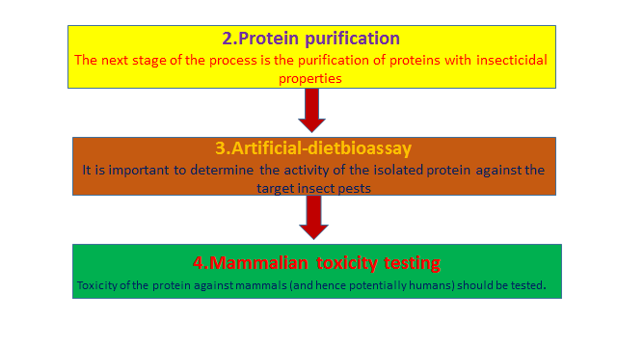

Slide 35
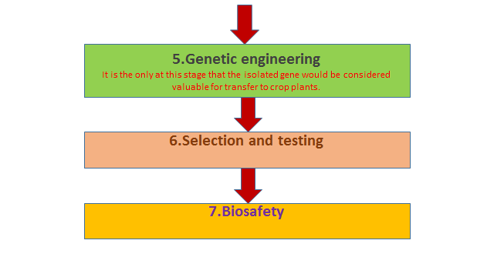

Slide 36
HOST-PLANT RESISTANCE TO PEST
The strategy also takes account of the fact that host-plant resistance to pest is universal and fall into two major categories.
1.Horizontal resistance
This type of traits is polygenic; that is, it results from the cumulative effect of several minor gene characters. This form of resistance does not involve gene- gene matching.
2.Vertical resistance vertical resistance typically arises from one major gene with a high level of expression. The mechanism of resistance may well involve gene- gene matching.

Slide 37
CASE STUDY
Resistance of Bt maize to the European corn borer and other pests

Slide 38
INTRODUCTION
Ostrinia nubilalis pest all over the world
Central pith of stalk is damage by larvae
Bt crops gain approval in mid-1990’s for commercial planting.
14% of Bt corn produced in 2004
Commercial development required optimal quality of desired trait, copy number, integration and transgene expression

Slide 39
COMMERCIAL LINE DEVELOPMENT
Transformation done in Bacillus thuringensis
Cry gene family i.e., Cry1Ab (Bt176, Bt11, Mon810), Cry1Ac (Bt-xtra, Dekalb), Cry1F (Herculex, Mycogen) and Cry9C (starlink, Aventis)
Cry1Ab commonly used
Codon optimization

Slide 40
Bt176 FIRST COMMERCIAL LINE
Knockout (Novartis) and Nature Guard (Mycogen)
Two different Cry1Ab genes constructs
One construct controlled by Phosphoenolpyruvate carcoxylase promoter
Second construct controlled by pollen-specific protein kinase gene
Least effective and potentially toxic to pollens

Slide 41
SIGNIFICANCE
Cry1A, Cry3A modification was used under Agrobacterium T-DNA promoter and Cauliflower mosaic virus 35s.
Low expression in tomato, potato and tobacco plants.
Stability increase by codon optimization of prokaryotic gene
Target specific pests
Cotton and maize give stability wit Bt Cry gene

